Slide 1
OUTPUT DEVICES
Presented By :
JAF/IT/2019/F/0006
JAF/IT/2019/F/0007
JAF/IT/2019/F/0008
JAF/IT/2019/F/0009
JAF/IT/2019/F/0010

Slide 2
Flow of presentation
Introduction
Types of output device
Introduction
An output device is an electromechanical device that accepts data from a computer and translates them in suitable form for the users.
Output devices generate computer output that can be broadly classified into two types:-
(1). Soft-copy output:-They are temporary in nature
(2). Hard-copy output:- They are permanent in nature and can be kept in paper files or can be looked later when the person is not using a computer
Types of output device
 Monitors
 Printers
 Plotter
 Projector
 Voice response system

Slide 3
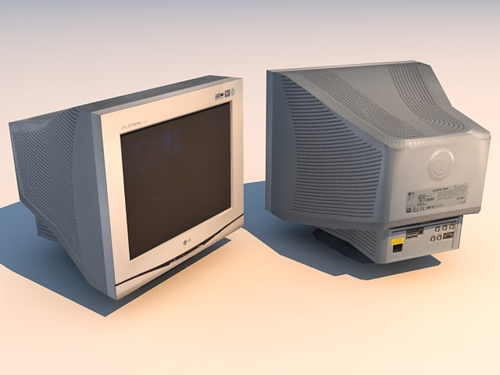
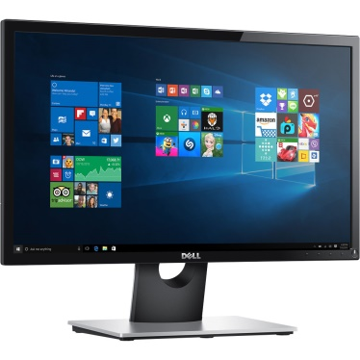
Monitors
Monitor are the most popular output device used today for producing soft-copy output
A monitor is associated usually with a keyboard and together they form a video display terminal
Two basic types of monitor:-
  (1). Cathode Ray Tube(CRT):- The CRT monitor displays images with color that are consistent and can be viewed with different angles.
  (2). Liquid Crystal Display(LCD):- The LCD monitor are thin and they use little space. They are light in weight, consume less energy.

Slide 4

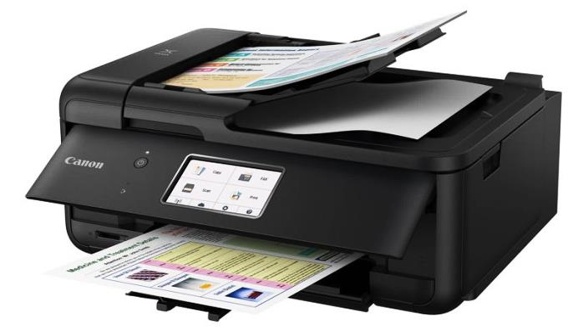
Printer
The printer is a device that print text document and images on paper
It is a peripheral output device.
Printers can be classified in two group- impact printers and non-impact printers
There are different types of printers:-
(1).Dot-Matrix:- Dot-Matrix printers are character printer that print one character at a time. They form character and all kind of images as patterns of dots.
(2).Inkjet:- Inkjet printers are character printers that form characters and all kinds of images by spraying small drops of ink on a paper.
(3).Laser Printer:- The Laser Printer uses a beam of laser for the purpose of printing and it is consists of a revolving cylinder that is made up of photoconductive material

Slide 5
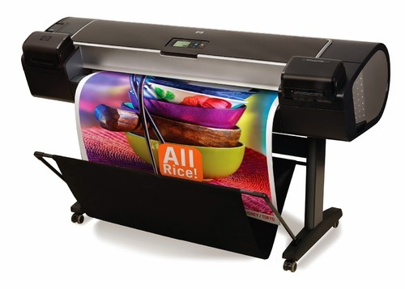
Plotter
Plotter are an ideal output device for architects, engineers, and others who need to routinely generate high-precision, hard-copy, graphic output of widely varying sizes.
There are two types of plotter:-
  (1).Drum Plotter:- In a drum plotter, the paper on which the design is to be made is placed over a drum that can rotate in both clockwise and anti-clockwise direction to produce vertical motion.
  (2).Flatbed Plotter:-A flatbed plotter plots design or graph on a sheet of paper spread and fixed over a rectangular flatbed table.
Plotter

Slide 6
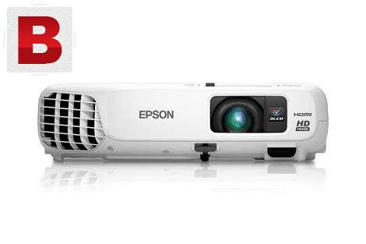
Projector
Screen image projector is an output device used to project information from a computer on a large screen
Additionally, a full-fledged multimedia presentation with audio, video, image and animation can be prepared and made by using this facility.
Like monitors, screen image projectors provide a temporary, soft-copy output
Projector

Slide 7
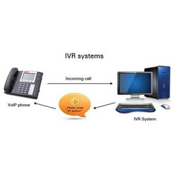

Voice Response Systems
Just as a speech recognition system allows a user to talk to a computer, a voice response system enables a computer to talk to a user
Voice response systems are of two types:-
  (1).Voice reproduction system:- A voice reproduction system produces audio output by selecting an appropriate audio output from a set of prerecorded audio responses
  (2).Speech synthesizer:- A speech synthesizer converts text information into spoken sentences. To produce speech, these device combine basic sound units called phonemes

Slide 8
Question Time?
Thank You

